Slide 1
Donation of Printing Machineries
Shing Fat Printing Press
July 2021

Slide 2
Items to Donate

Slide 3
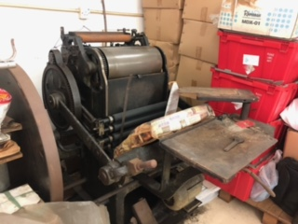
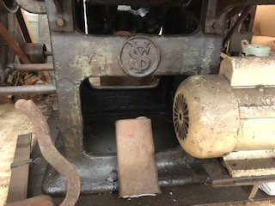
Items to Donate
Item 1 – Manual Feed Printing Machine
Dimension: ~ 5ft x 5ft x 4.5ft

Slide 4
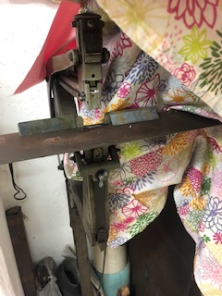
Items to Donate
Item 2 - Paper Shearing Machine
Size: ~ 5ft x 5.5ft x 5.5ft
Item 3 – Manual Stapling Machine
Size: ~ 3ft x 4ft x 4.5ft

Slide 5
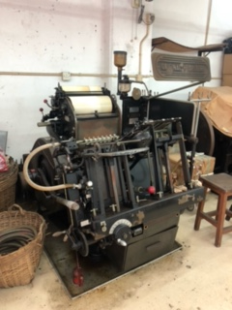
Items to Donate
Item 4 (tentative) – Auto feed printing machine
Size: ~ 5ft x 5ft x 5.5ft
Note: Our neighbour printer is interested in using the machine. The donation of this machine may be delayed to a few years later after his usage.

Slide 6
Items to Donate
Item 5 – Movable metal type and moulds, sample printed materials and drawers
Size: ~5ft x 4ft x 5ft

Slide 7
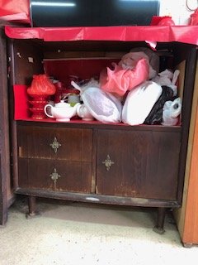
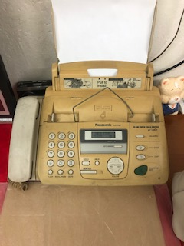
Items to Donate
Item 6 – Cupboard, fax machine, and decorations like pictures if needed

Slide 8
Donors

Slide 9
Donors
Mr Au Man Shing 歐文勝 (Founder of Shing Fat Printing Press)
Ms Ng Mee Mee 伍美美 (Spouse of Mr Au)
Shing Fat Printing Press 勝發印務

Slide 10
Shing Fat Printing Press

Slide 11
Shing Fat Printing Press
Mr Au was born in Macau. He moved to Hong Kong to work when he was a teenager and started as an apprentice printer in a printing shop in Central.
Shing Fat Printing Press (“Shing Fat”) was set up in 1972 and rented two units in Cheung Sha Wan Factory Building.
Shing Fat is a typical family run business with very manual operations, providing printing service to offices including foreign trading companies (called “Hongs”), schools, etc. Printed materials include office invoices, receipts, orders, school handbooks, etc.
Mr Au mainly worked by himself with the assistance of his wife Ms Ng. Mr Au’s sister and sister-in-law would also provided part-time help during peak season. His children would also helped during holidays.

Slide 12
Shing Fat Printing Press
Due to the demolition of Cheung Sha Wan Factory Building, Mr Au moved the business to Wang Cheong Factory Estate in 2003.
Though a small business not making big money, yet Shing Fat was able to support Mr Au’s family and provided education for his four children till their university graduation.
Mr Au passed away in late 2019 at the age of 90.

Slide 13
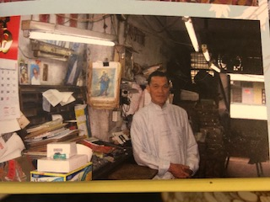
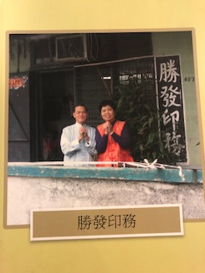
Shing Fat Printing Press
Old factory at Cheung Sha Wan Factory Building

Slide 14
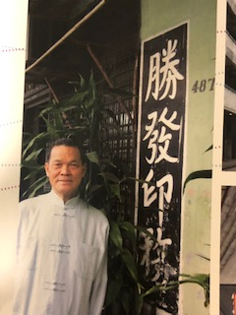
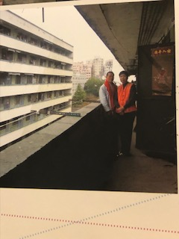
Shing Fat Printing Press
Old factory at Cheung Sha Wan Factory Building

Slide 15
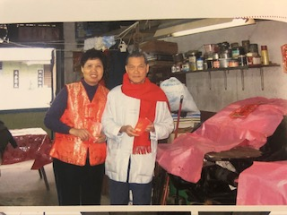
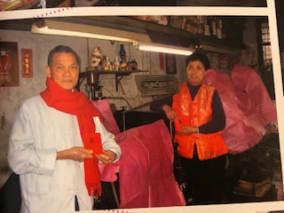
Shing Fat Printing Press
Old factory at Cheung Sha Wan Factory Building

Slide 16
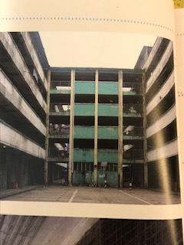
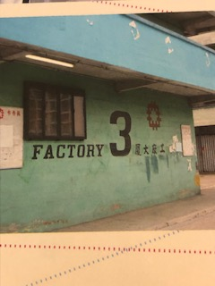
Shing Fat Printing Press
Old factory at Cheung Sha Wan Factory Building

Slide 17
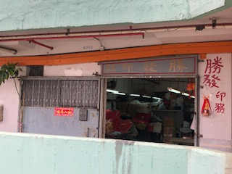
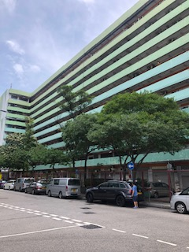
Shing Fat Printing Press
New factory at Wang Cheong Factory Estate

Slide 18
Contact

Slide 19
Contact
Au Man Yee Teresa (daughter of Mr Au)
Mobile: 9029-8458
Email: tmya@netvigator.com

Slide 20
Thank you

